Slide 1

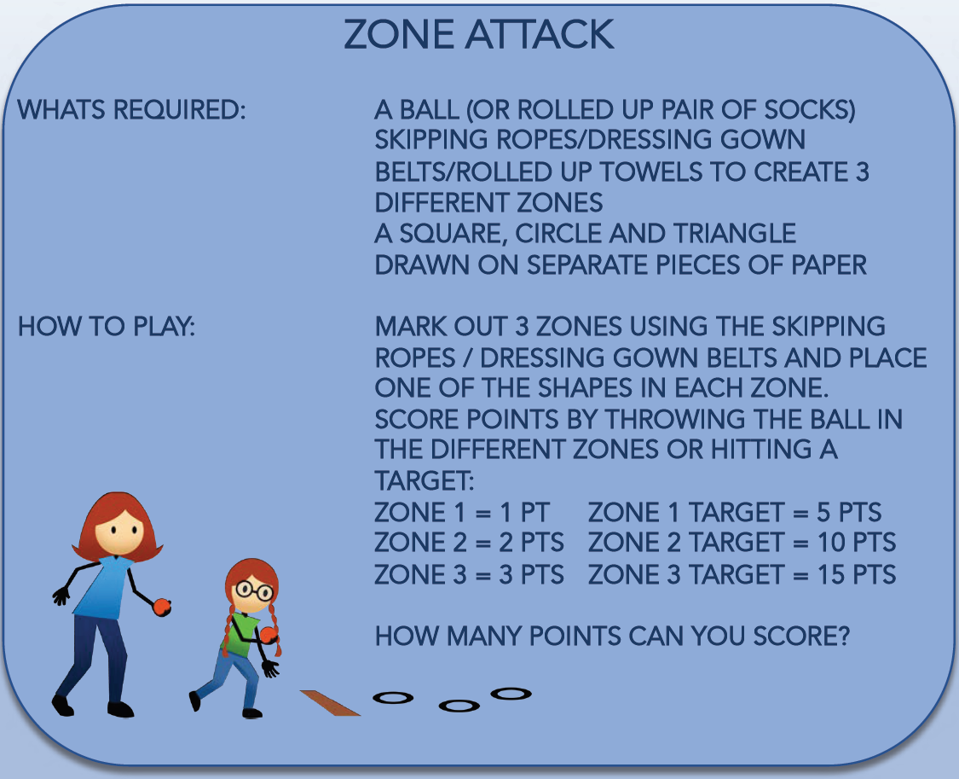
MONDAY 8th FEBRUARY– KEY STAGE 2

Slide 2
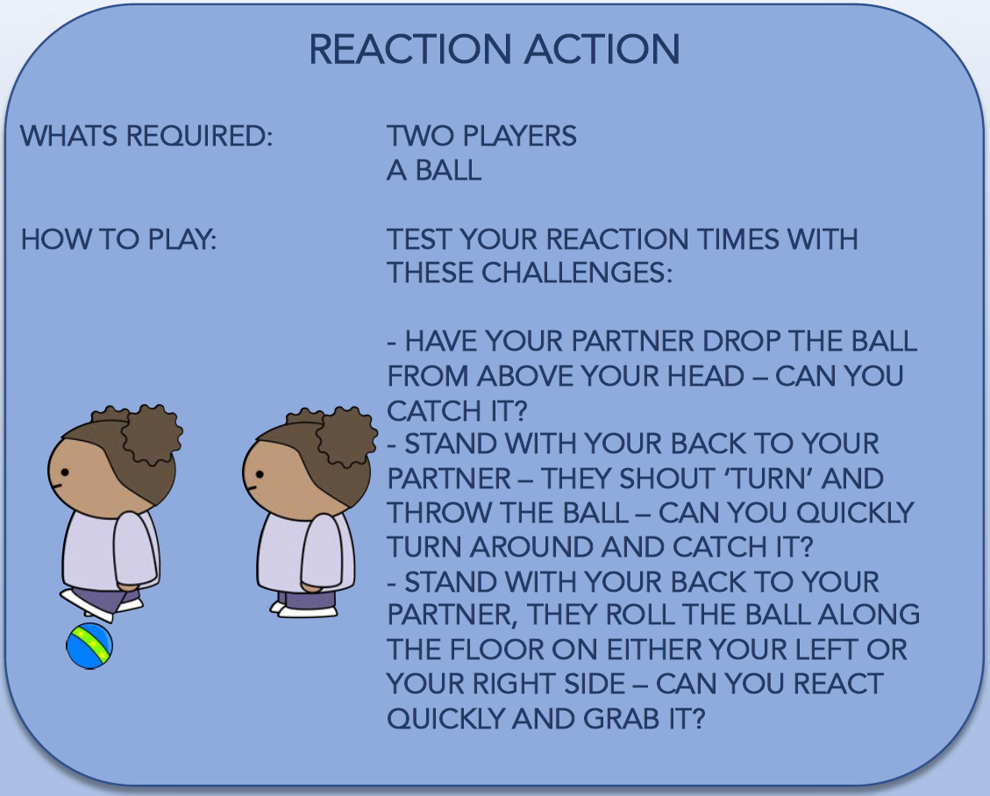
TUESDAY 9th FEBRUARY– KEY STAGE 2

Slide 3
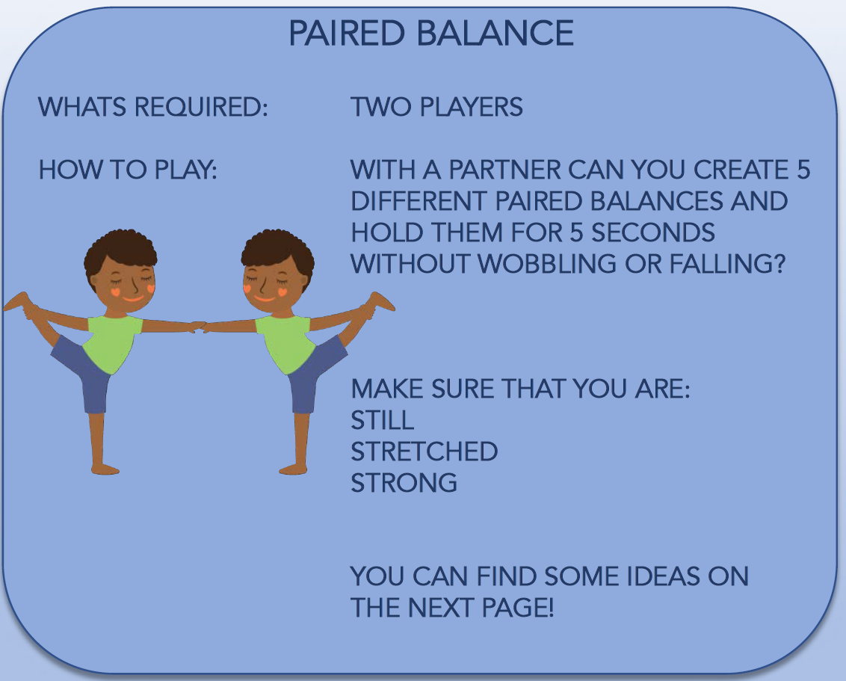
WEDNESDAY 10th FEBRUARY– KEY STAGE 2

Slide 4
WEDNESDAY 10th FEBRUARY– KEY STAGE 2

Slide 5
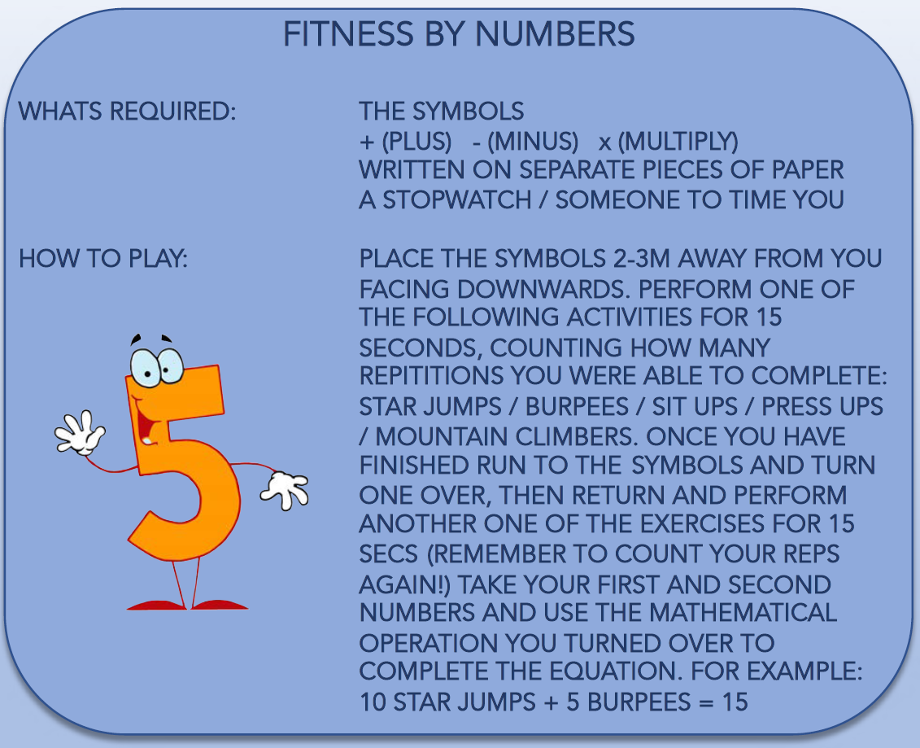
THURSDAY 11th FEBRUARY– KEY STAGE 2

Slide 6
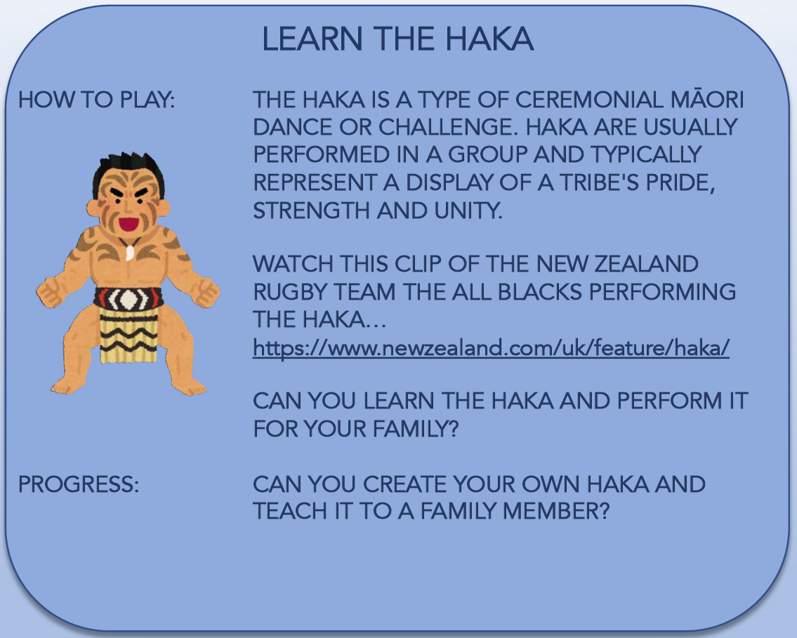
FRIDAY 12th FEBRUARY– KEY STAGE 2

